Slide 1

TIPANGLE: Accurate Pan and Tilt angle determination of Traffic Cameras
Presenter: Shreehari Jagadeesha
Committee Faculty: Chair Aviral Shrivastava, Professor Nakul Gopalan, Professor Aman Arora
Notes:
Good Morning Respected Chair Professor Aviral Shrivastava and Committee members Professor Aman Arora and Professor Nakul Gopalan, I welcome you to my defense presentation.

Slide 2
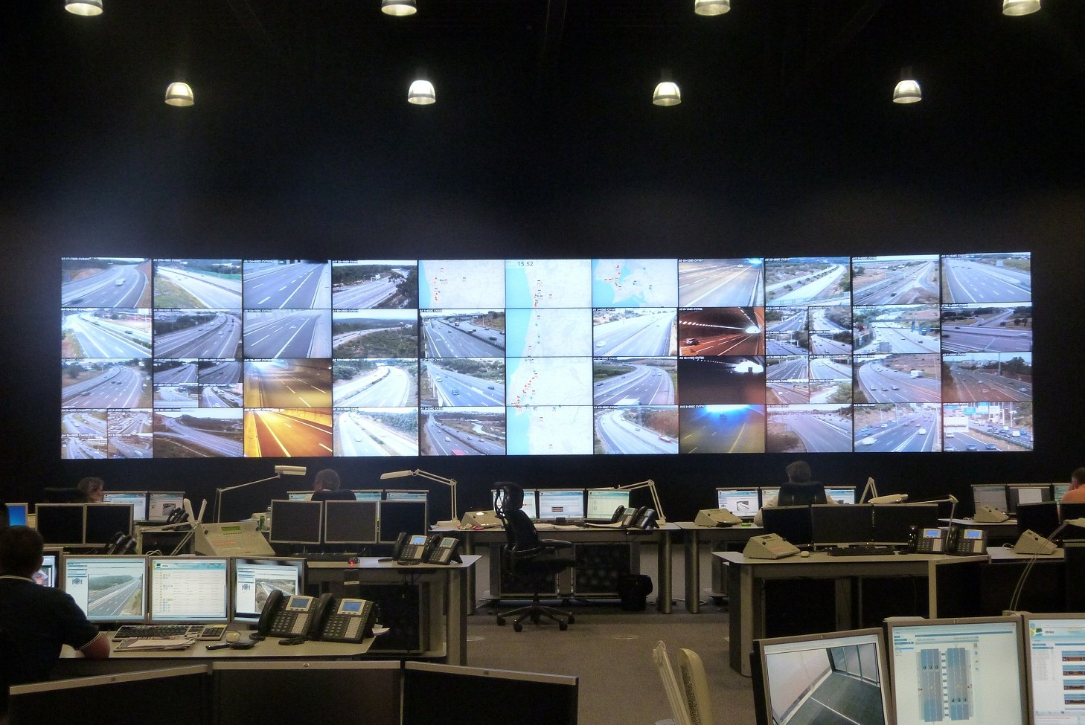
Increasing Digitization for Traffic Monitoring
Traffic Management & Safety is a major concern which cannot be ignored in a world of ever-growing number of vehicles on the road.
Traffic Control Divisions throughout the world rely on digitalization because of the benefits it brings in managing traffic. For example,
Easing congestion.
Detecting accidents and notifying emergency services.
Thereby, use of traffic cameras are a at steady rise.
Manhattan in NY alone has 868 traffic cameras.
Notes:
Rise in number of vehicles.
Managing would become an issue.
Hence use of digitalization.
Because of this, use of number of traffic cameras increases steadily.
Monitoring all traffic cameras by personal only would not be possible.

Slide 3
Opportunities Using the Traffic Camera
Tracking anomalies in traffic flow.
Effective traffic light management using the traffic data.
Rerouting traffic. i.e., Easing Congestion at mass gathering events such as match day.
Estimating Travel times based on real time data without using actual GPS data of the traffic.
Tracking suspect vehicles in a city without the need of actual need of chasing/pursuit.
Multiple vehicles can be tracked as POLICE personal is limited in no for chasing.
Autonomous vehicles can be tracked by MVD to check if they are functioning properly and have not gone rouge.
Effectively noting incidents and immediately notifying emergency services for a quick response.
Notes:
Usage of traffic cameras brings in a lot opportunities in the field of research to increase safety.

Slide 4
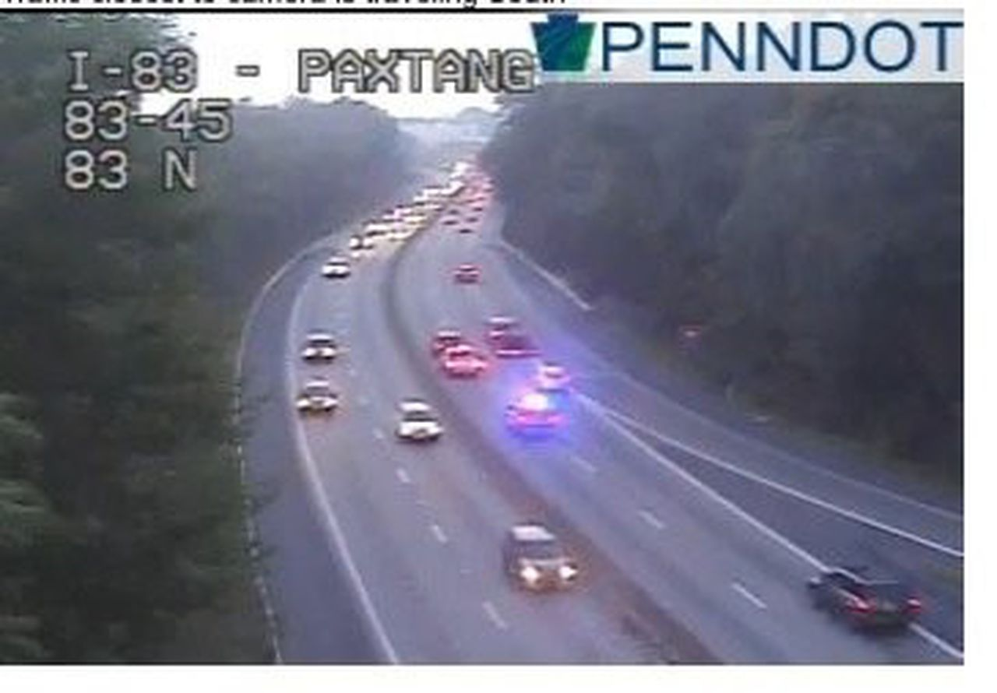
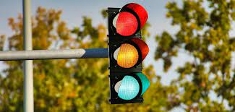
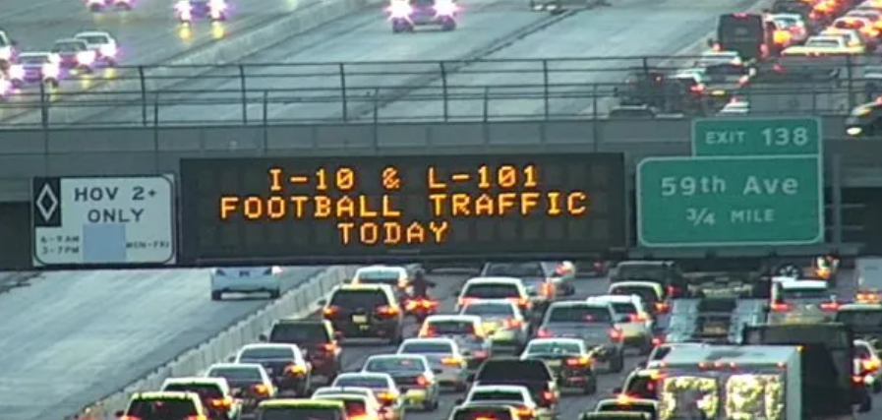
Problem Statement – Localization of Vehicles
Monitoring every traffic camera on live is not practically possible by the Traffic monitoring personal.
Hence, localizing the live traffic onto a map would be an effective solution which can answer the opportunities mentioned in the previous slides.

Slide 5
Challenge – Localization while changing Camera Pose
Localization of vehicles on the map necessitates continuous calculation of camera pose to reduce errors.
Traffic cameras often lack sensors in them to determine their pose with respect to the world in turn challenging their data venerability.
Pose of traffic cameras change,
Traffic monitoring personal may have changed the pose to track the construction at a site and might have forgotten afterwards.
Natural causes such as wind and rain.
Notes:
The data obtained from traffic camera must be venerable/dependable.
If the data obtained from the camera is faulty, errors are induced while localizing.
Before localizing accurate camera pose must be known.
However, Camera pose are often changed due to both natural and traffic personal causes and most often cameras lack encoders or IMU in them to track their pose change.

Slide 6
Existing Approaches and their Limitations
M. Pollefeys, R. Koch and L. Van Gool, "Self-calibration and metric reconstruction in spite of varying and unknown internal camera parameters," Sixth International Conference on Computer Vision, 1998.
The pose is estimated by computing the focal length and optical center
This approach is a computationally intensive procedure involving determination of focal length and optical center.
K. . -T. Song and J. . -C. Tai, "Dynamic Calibration of Pan–Tilt–Zoom Cameras for Traffic Monitoring," in IEEE Transactions on Systems, Man, and Cybernetics, Part B (Cybernetics), vol. 36, no. 5, pp. 1091-1103, Oct. 2006
Uses images of lane markings on road which is later fed to DNN for pose estimation.
Not applicable at intersections lacking lane markings.
H. Nagayoshi and M. Pollefeys, "Estimating Camera Pose Using Trajectories Generated by Pan-Tilt Motion," 2014 2nd International Conference on 3D Vision, Tokyo, Japan
Tracks using a marker placed on target camera being observed by other cameras.
Requires the use of multiple high-definition cameras and target marker.
H. Dinh and H. Tang, "Camera calibration for roundabout traffic scenes," 2014.
Uses the elliptical equation on the roundabout to determine the pose of the camera.
Only applicable to roundabouts.

Slide 7
Methodology

Slide 8
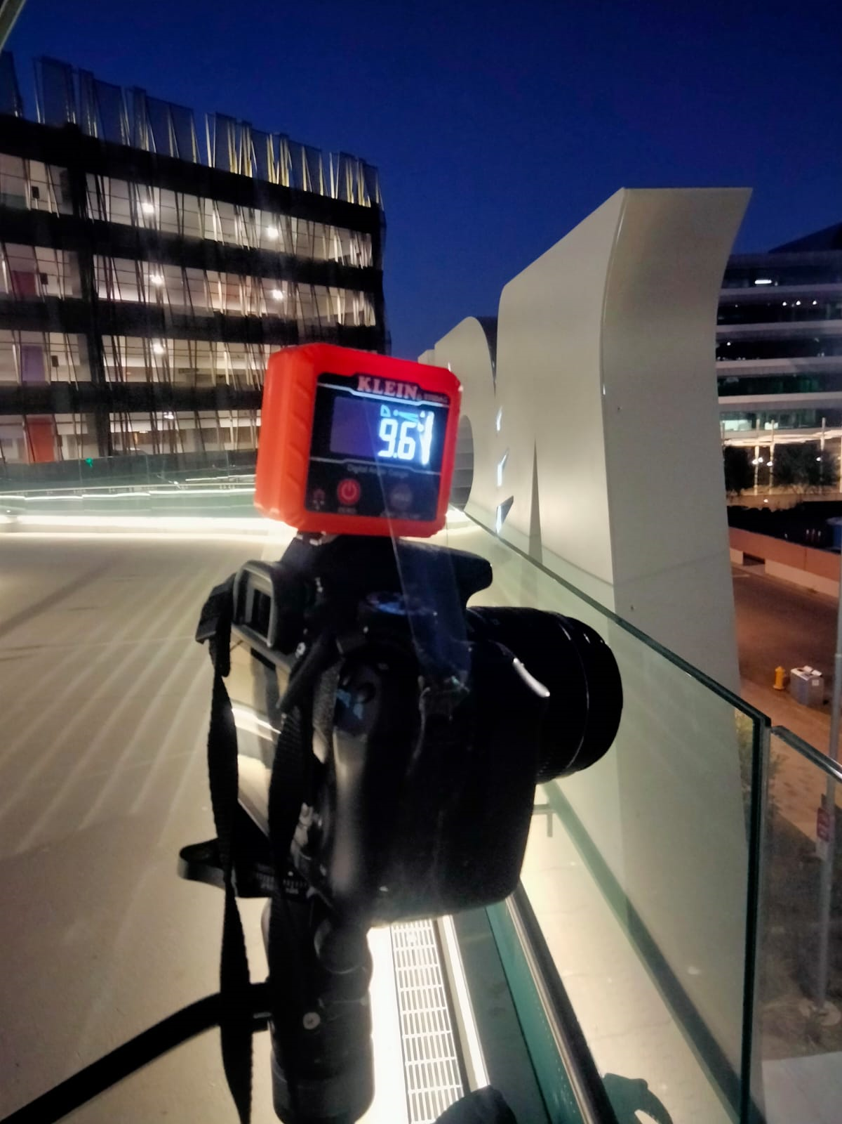
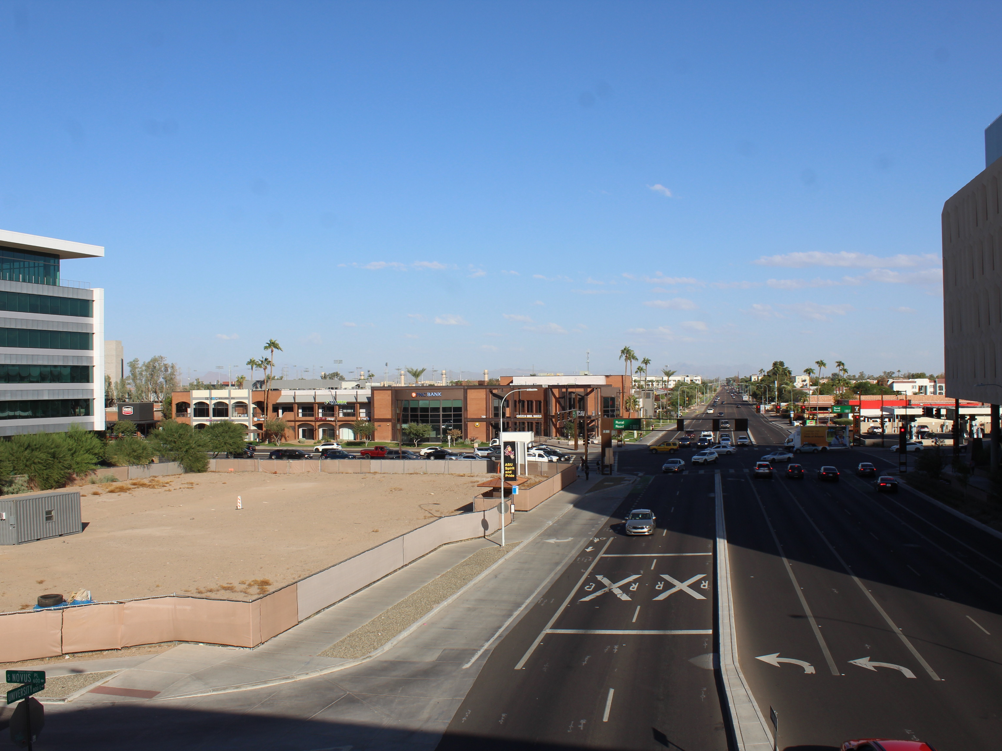
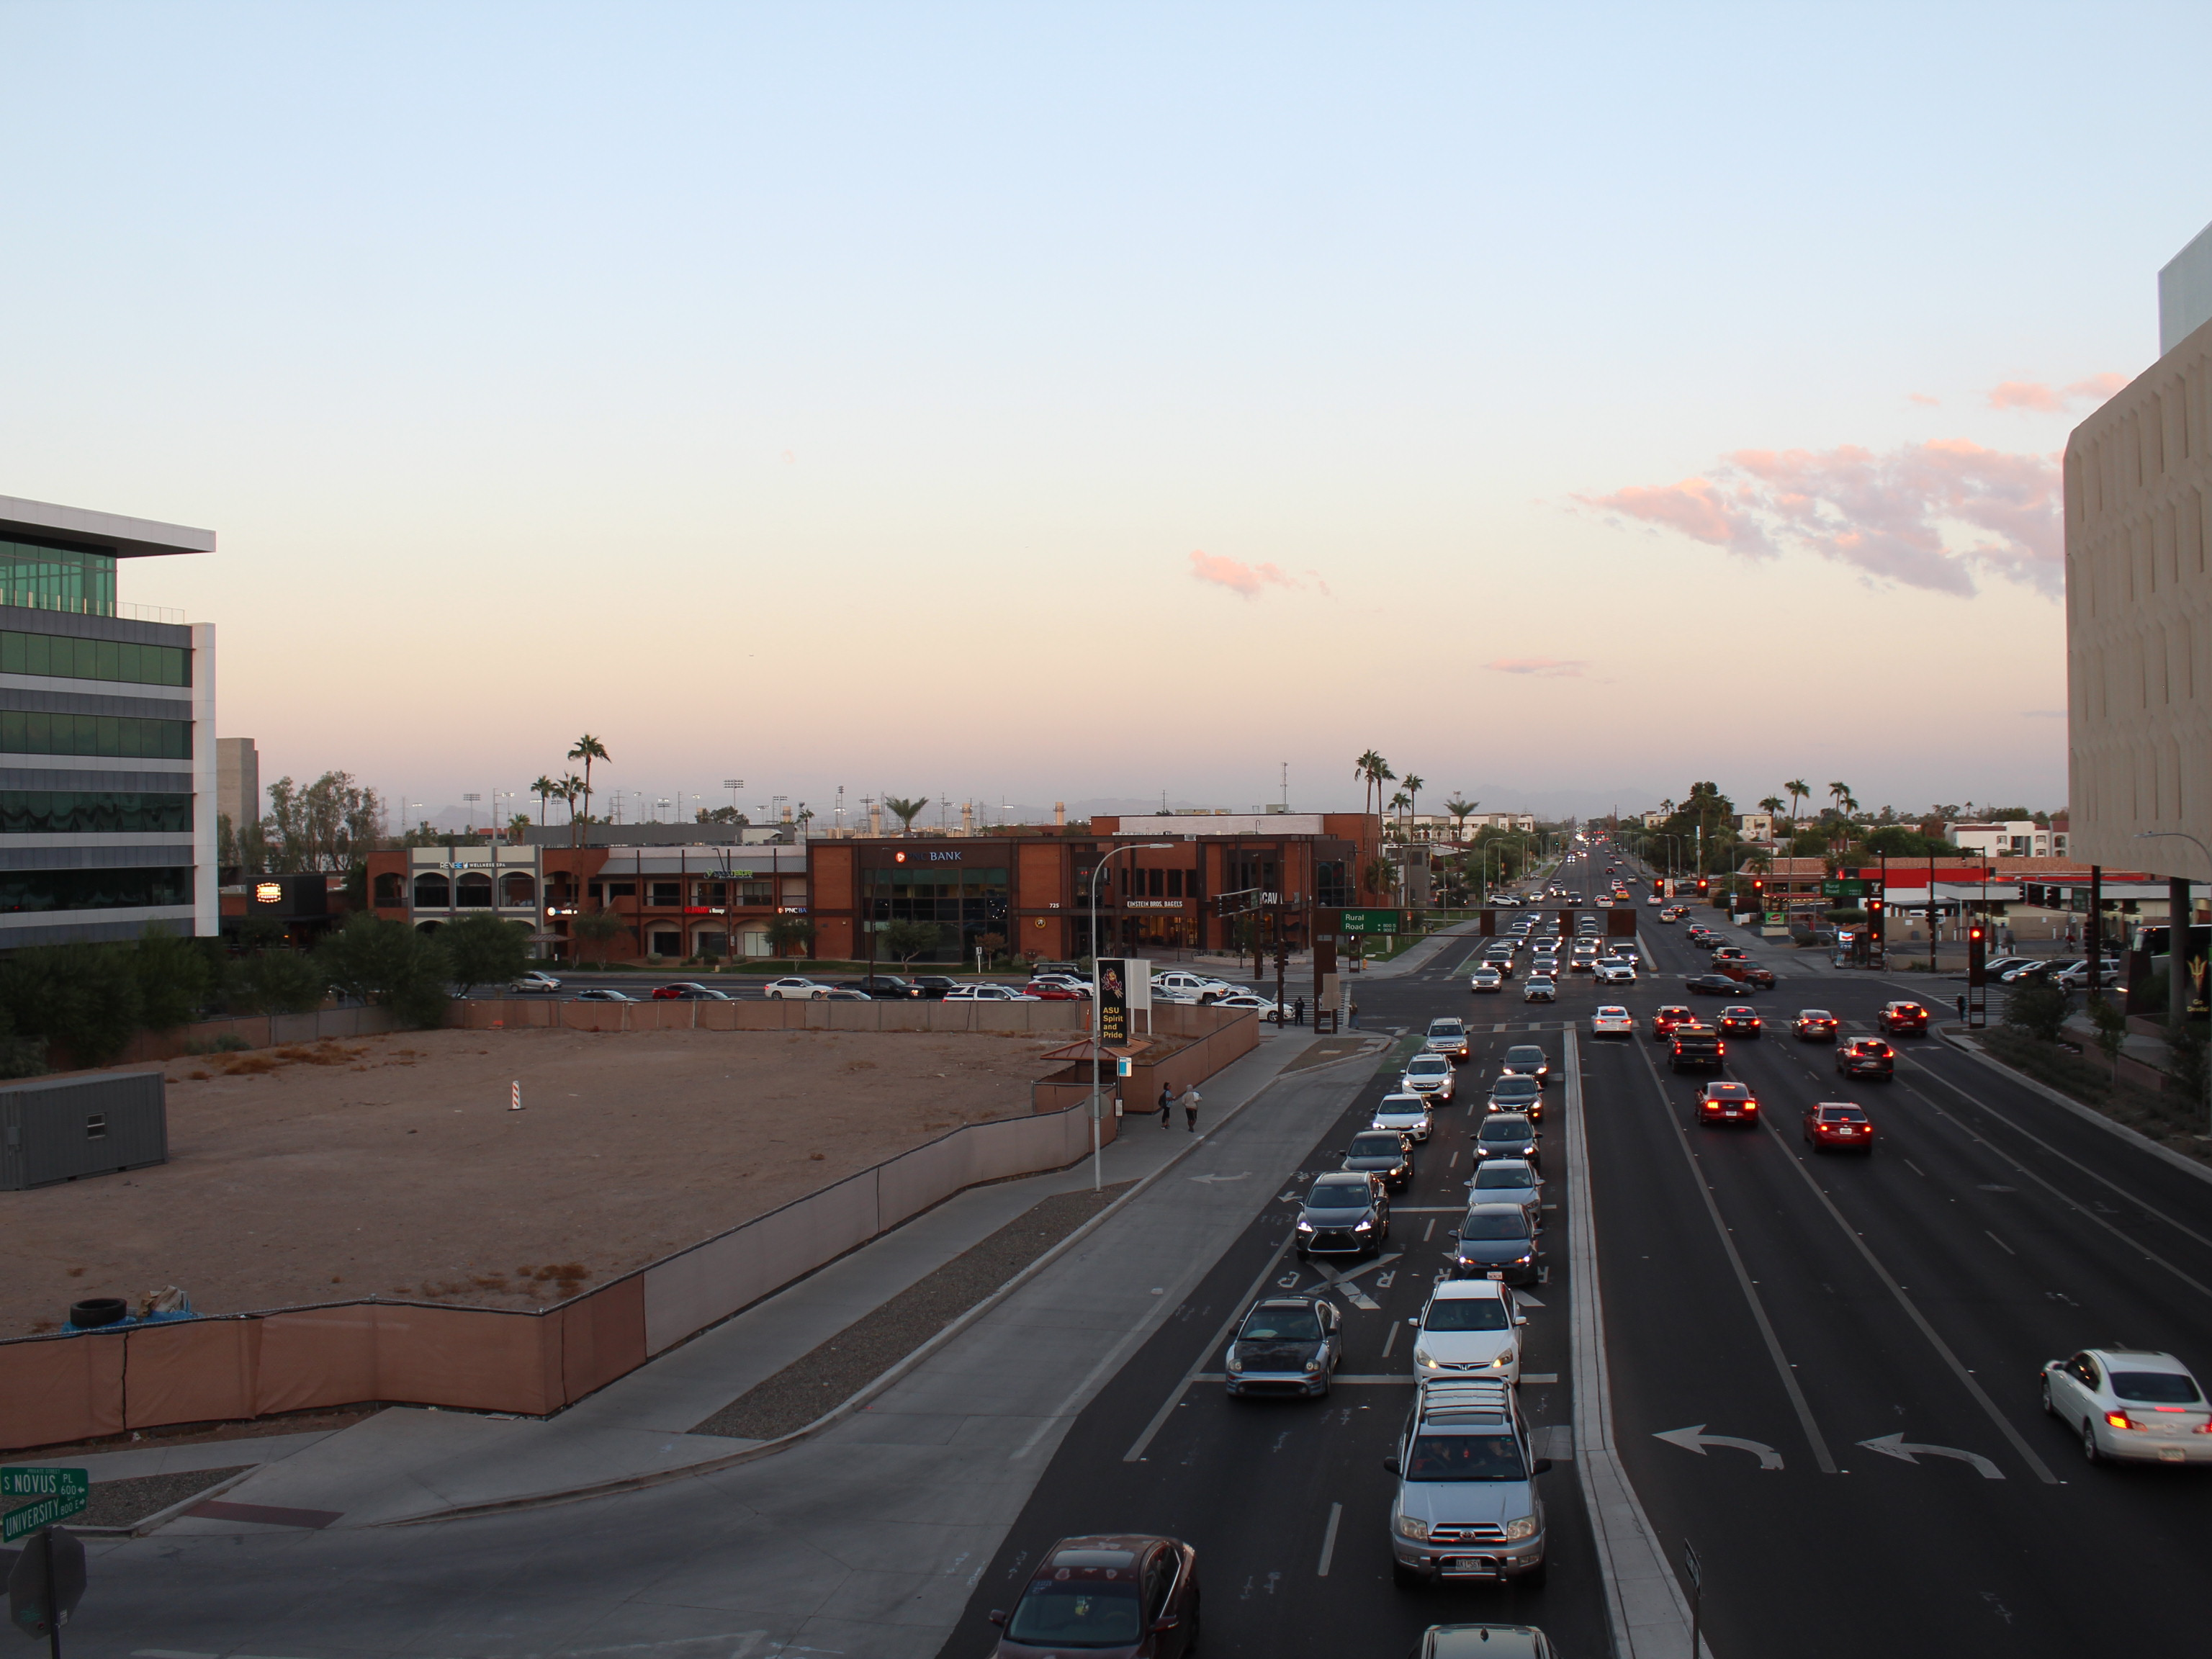
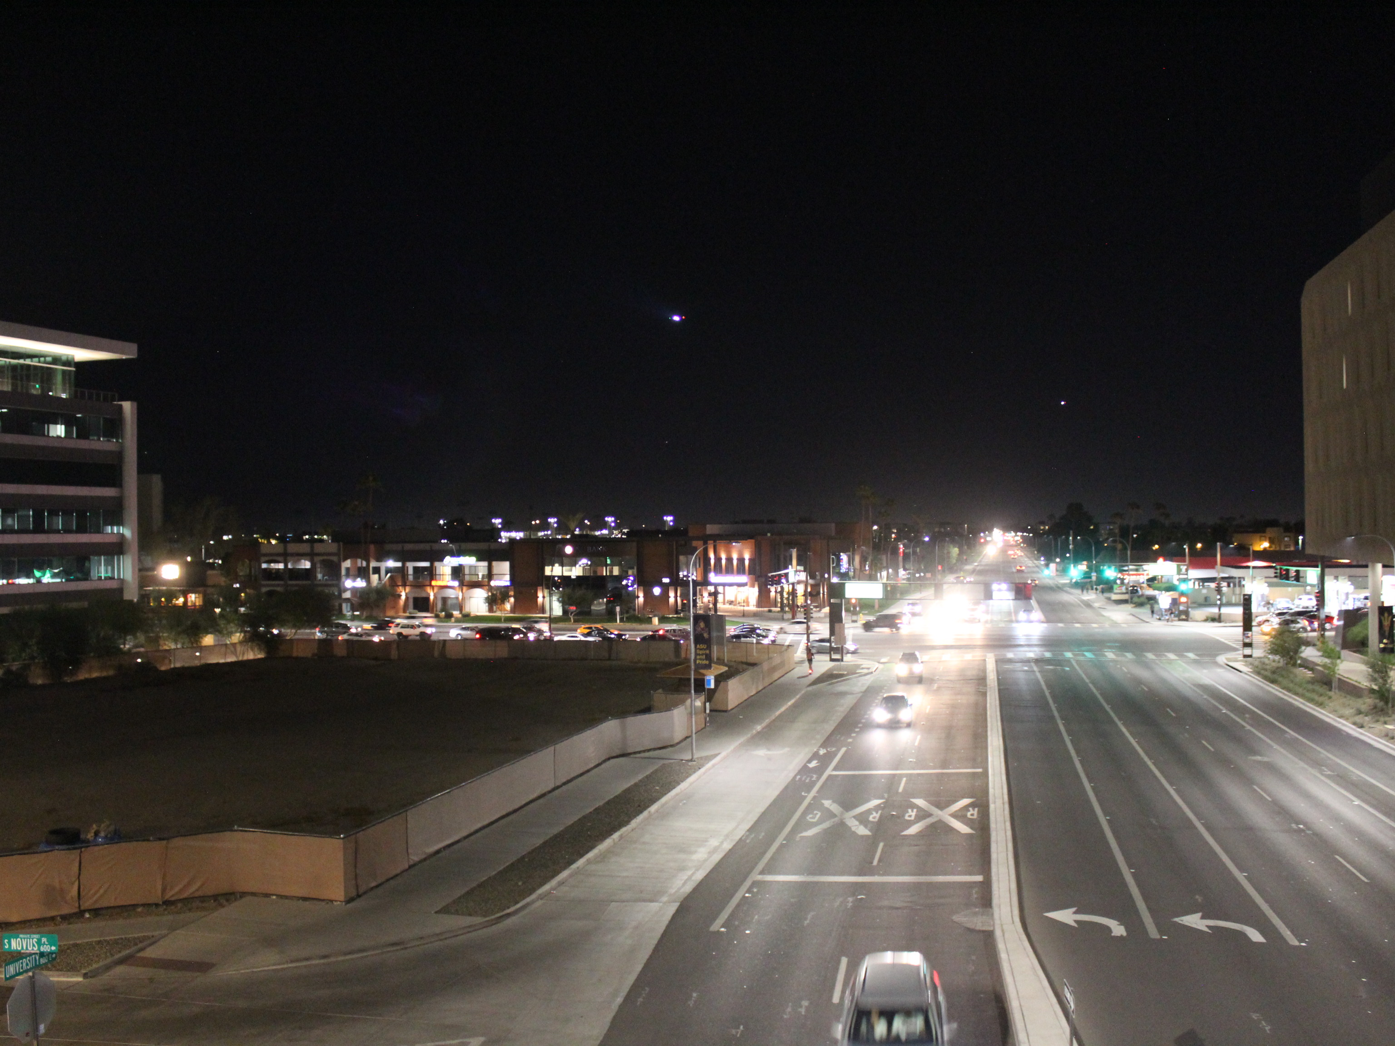
Step 1 – Image & Corresponding Angle Dataset Collection
A completely new dataset of 195 images are collected during day, dusk and night times with multiple PAN and TILT angles from the bridge over University Drive covering the Rural Road and University Drive intersection for training and validation purposes . link
Another 90 separate images were taken at random angles for testing purpose. link
0,-0.5 | 2.5,-0.5 |  |  |  |  | 15,-0.5 |  |  |  |  | 27.5,-0.5 | 30,-0.5
0,-3.0 | 2.5,-3.0 |  |  |  |  | 15,-3.0 |  |  |  |  | 27.5,-3.0 | 30,-3.0
0,-5.5 | 2.5,-5.5 |  |  |  |  | 15,-5.5 |  |  |  |  | 27.5,-5.5 | 30,-5.5
0,-8.0 | 2.5,-8.0 |  |  |  |  | 15,-8.0 |  |  |  |  | 27.5,-8.0 | 30,-8.0
0,-10.5 | 2.5,-10.5 |  |  |  |  | 15,-10.5 |  |  |  |  | 27.5,-10.5 | 30,-10.5
Notes:
A completely new and accurate dataset has been collected at the bridge over the university drive from where the University Drive and Rural Road intersection can be completely covered by the camera.
A DSLR placed on steady tripod is used such that the pose and the location of the camera does not change randomly. The tripod has a PAN angle measurement scale with a 2.5 degree of step measurement between angles.

Slide 9
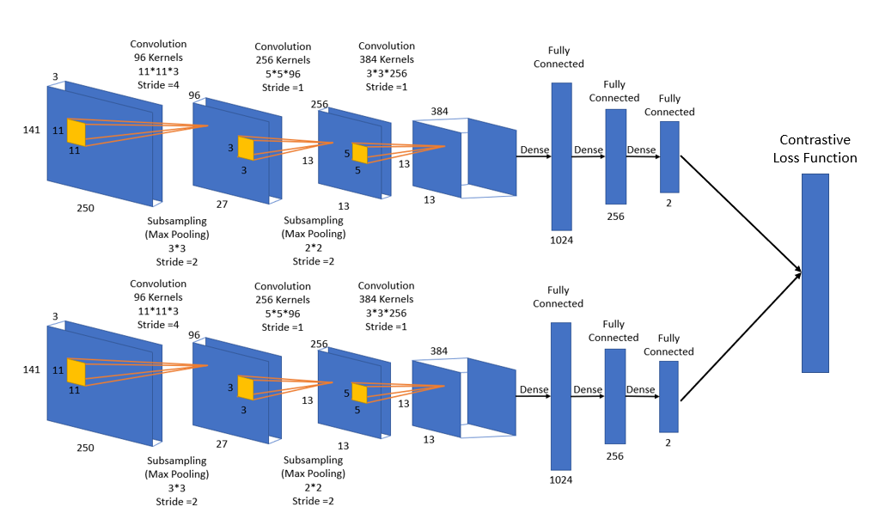
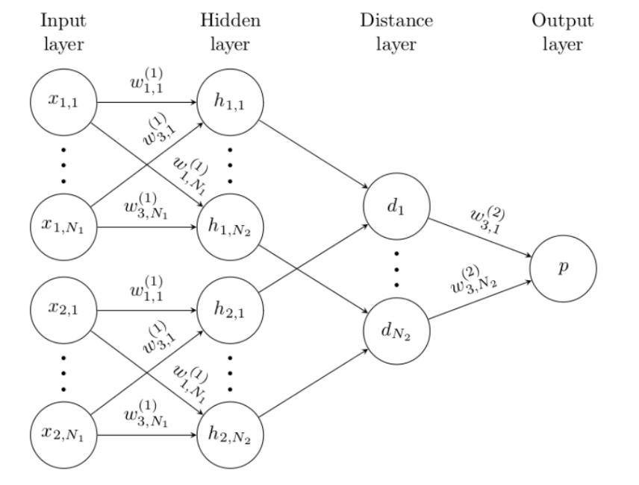
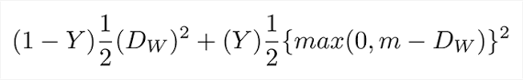
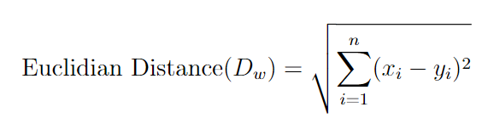
Step 2 – Train a Siamese Neural Network
Network embeddings to be presented in the figure
How Weights and Biases are getting changed

Slide 10
Step 3 - Inference
The same 195 images collected for the training are used as search space images.
An image is provided to the network for determining its pose.
Euclidian Distance between Input image embedding, and search space images embeddings is calculated.
Search space images are chosen using the gradient descent approach.
The search space image embedding having least Euclidian Distance with input image embedding would be the nearest matching image.
PAN and TILT angle from the nearest matching image is obtained as the solution.

Slide 11
Experiments and Results

Slide 12
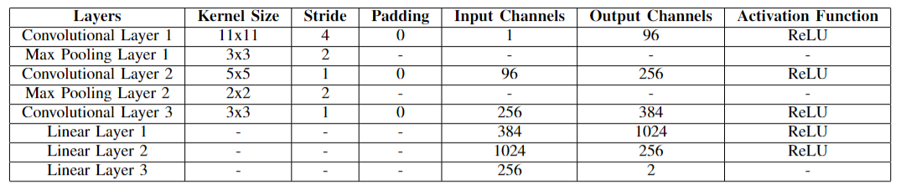
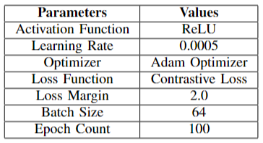
Used Siamese Neural Network Parameters

Slide 13
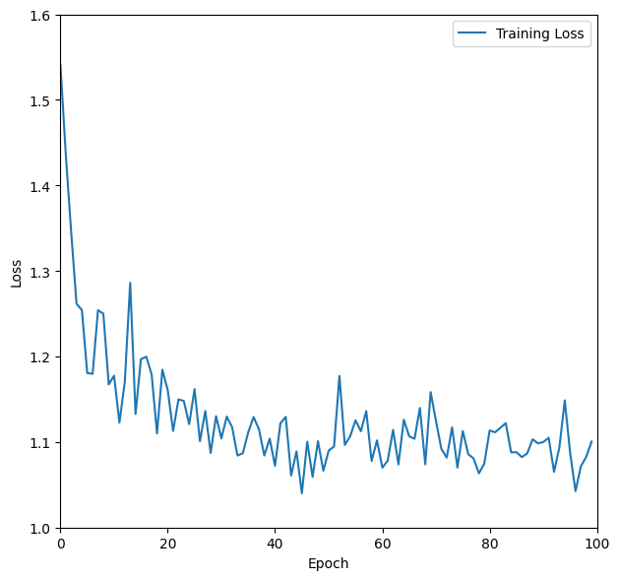
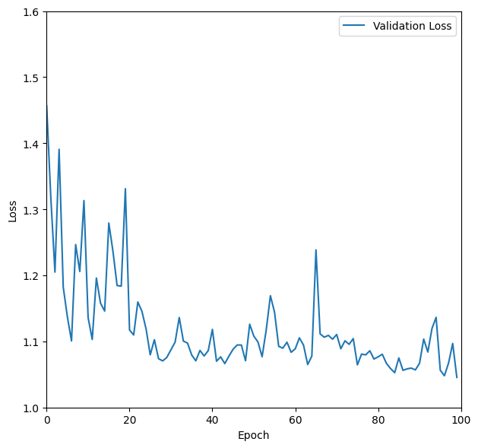
Training Results

Slide 14
TIPANGLE predicts PAN and TILT angles 4X more accurately and 2.5x faster
Approach/Time | TIPANGLE | RESNET18
Training Time | 6:48 Minutes | 37:26 Minutes
Inference Time | 1.627s | 3.713s
Notes:
It can clearly be seen here from the chart that ResNet18 performs poorly as opposed to TIPANGLE.
This is mainly due to the fact that ResNet18 requires large set of images as dataset for training.
Inference time is also poor for ResNet18, however the inference time of ResNet would not matter as the results are poor when compared to TIPANGLE.

Slide 15
Gradient Descent decreased Inference Time by 2x
Taking matched images as a grid, we can treat the problem as a search
The heuristic is whether the matching score is still falling or equal.
We start our search where the last best match was because it is more likely the camera did not move.
Here we see an example, in round 1 we explored the blue box, in round two we explored the yellow box, and in round 3 we explored the green and ended.
Performance with search heuristics decreases inference time by 2x
0,-0.5 |  |  |  |  | 12.5,-0.5 | 15,-0.5 | 17.5,-0.5 |  |  |  |  | 30,-0.5
0,-3.0 |  |  |  |  | 12.5,-3 | 15,-3 | 17.5,-3 |  |  |  |  | 30,-3.0
0,-5.5 |  |  |  |  | 12.5,-5.5 | 15,-5.5 | 17.5,-5.5 |  |  |  |  | 30,-5.5
0,-8.0 |  |  |  |  | 12.5,-8 | 15,-8 | 17.5,-8 |  |  |  |  | 30,-8.0
0,-10.5 |  |  |  |  | 12.5,-10.5 | 15,-10.5 | 17.5,-10.5 |  |  |  |  | 30,-10.5

Slide 16
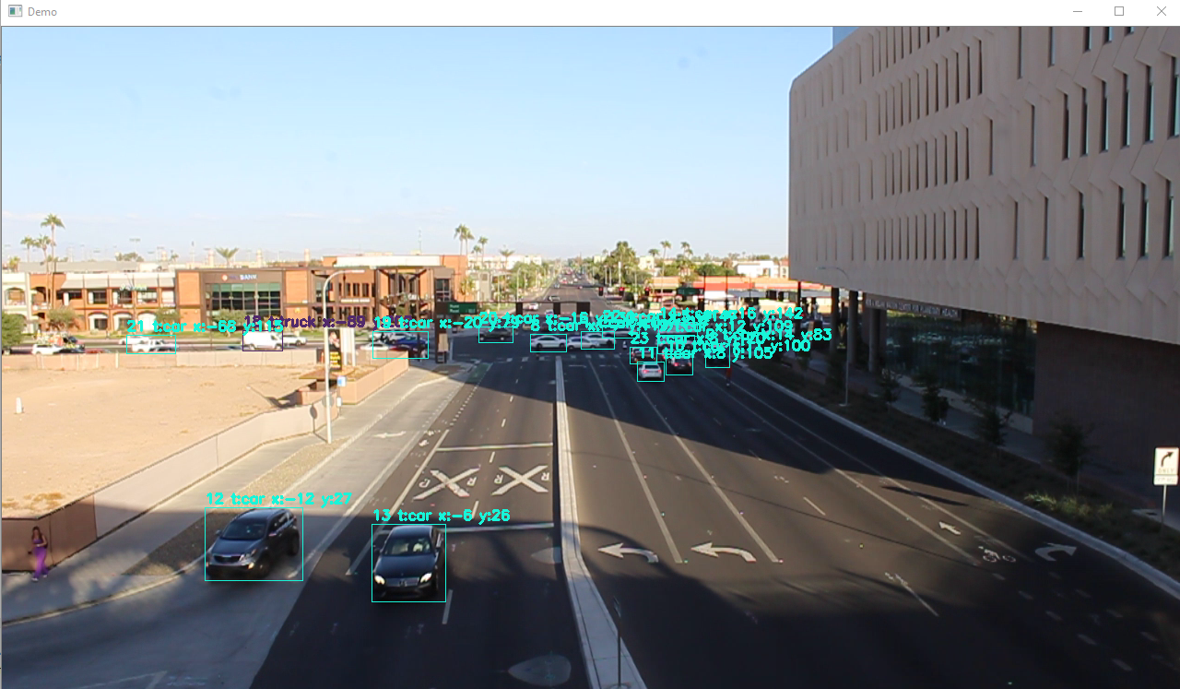
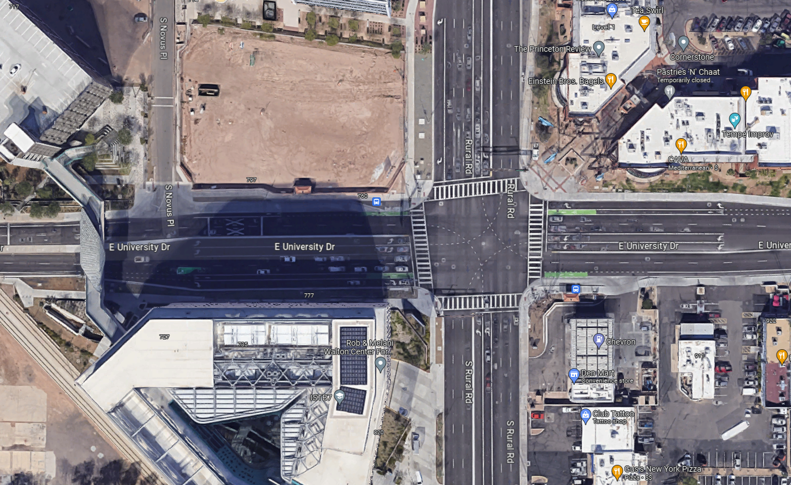
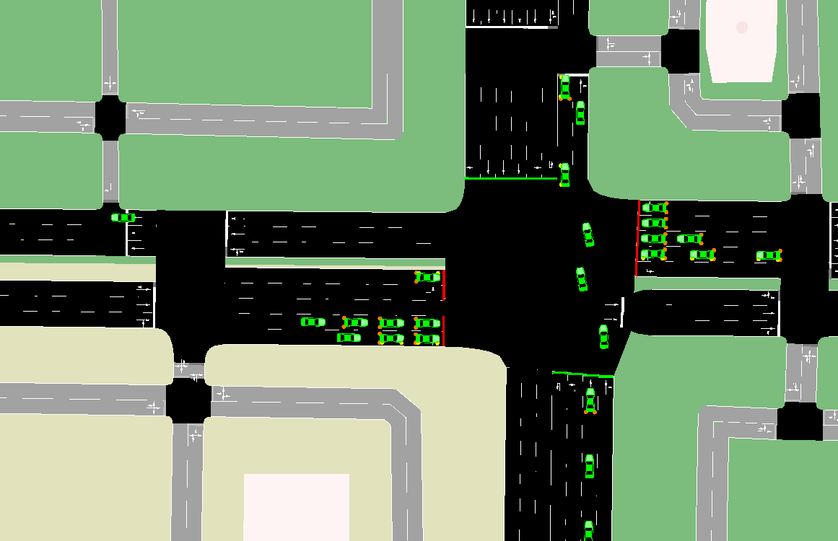
Using the Pose for Localization

Slide 17
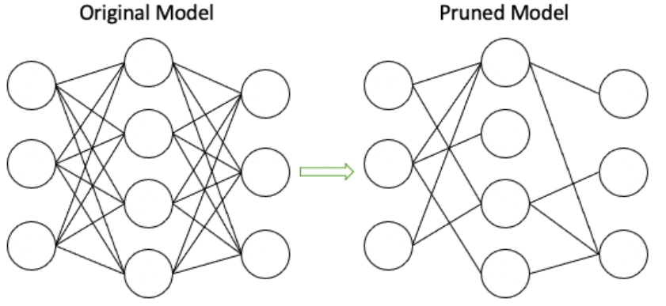
Pruning and Parallelization reduces Inference Time by 1/3rd :
Pruning refers to removal of unnecessary nodes whose weights are not helpful in inference.
The trained model is pruned for faster inference execution (60.43s to 54.28s).
Once pruned the model size is also reduced by 1/3rd.
As Raspberry Pi3 has 4 cores, exploiting the parallel processor would yield beneficial results in reducing the inference time
Parallelization is exploited for faster inference (54.28s to 38.18s).
Notes:
Pruning basically is removing neurons and their weights which contribute to actual prediction.
On implementing the inference on raspberry Pi3 and using pruning reduces the inference time drastically

Slide 18
Summary
Use of Digitization in Traffic monitoring has greatly improved the ability to effectively monitor traffic and has opened new opportunities in the field of research. With the advent of Machine Learning and use of traffic camera data, Localization of traffic into map is beneficial in many instances including easing congestion at a mass gathering events and tracking the suspect vehicle.
TIPANGLE an approach is proposed to determine accurate PAN and TILT angle of Pan Tilt Traffic Cameras which,
Avoids the need for estimating Intrinsic camera properties i.e., focal length and optical center.
Does not require IMU or Encoder units embedded in the camera.
Does not depend on the lane markings painted on the road.
Does not require the use of multiple cameras and markers placed on target camera.
Is ubiquitous and not specific to only roundabouts.
Performs 4x better on accuracy and 2.5x faster in time when compared to ResNet18
Gradient descent approach used reduce inference time by 4x
Pruning and parallel execution of the inference reduces inference time 1/3rd
Deployed on embedded system i.e., Raspberry Pi 3 show the light nature of the approach

